Slide 1
Automated Industrial Safety Management system
Abdullah Al Ishtiaq – 1505080
Shashata Sawmya – 1505089

Slide 2
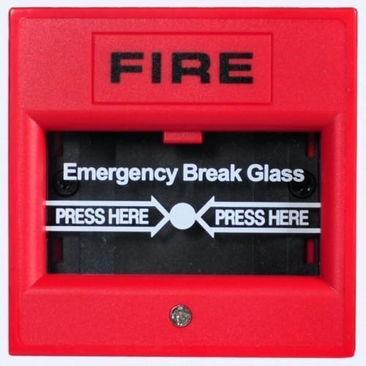
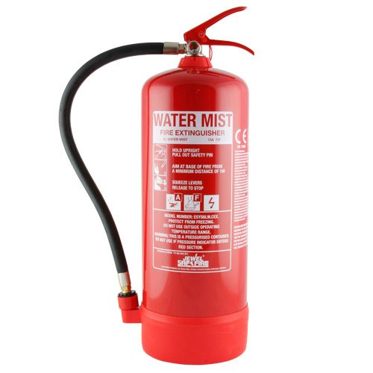

Today’s industrial safety management

Slide 3

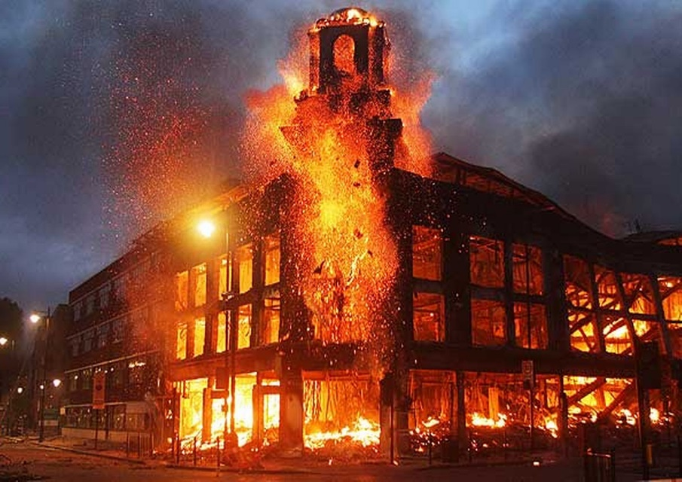
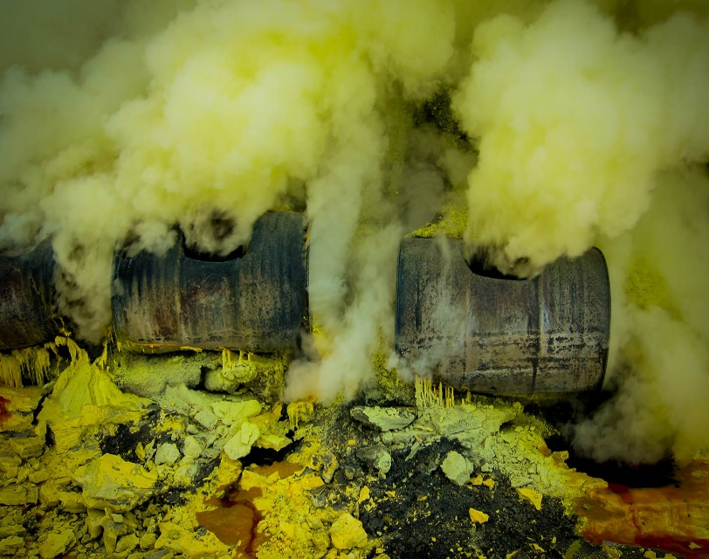
WHAT INDUSTRIAL HAZARDS ARE WE TRYING TO CONTROL
FIRE OUTBREAK
TOXIC GAS RELEASE

Slide 4
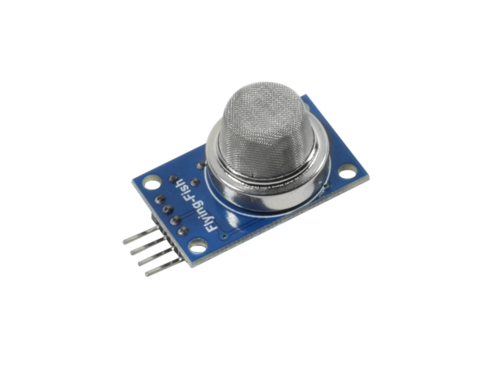
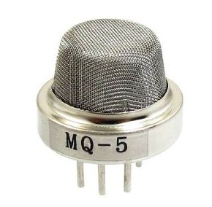
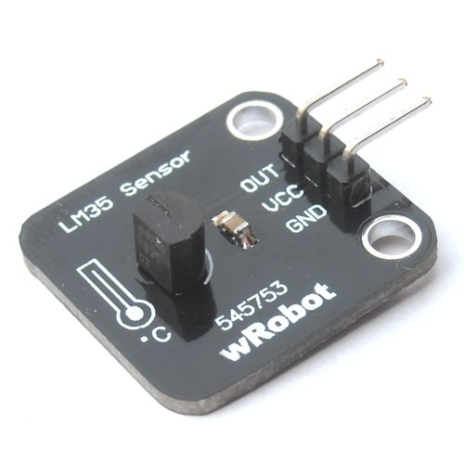
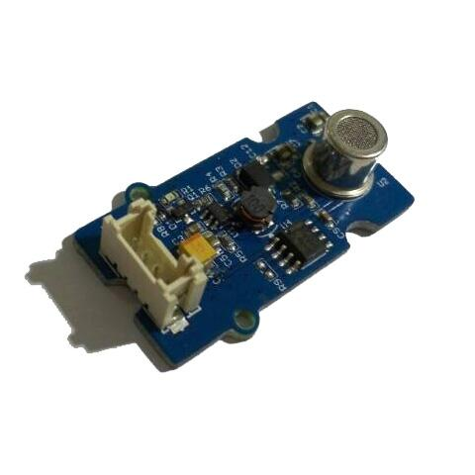
How are we detecting the industrial hazards automatically
MQ-5 GAS SENSOR
MQ-2 AND LM35 SENSOR FOR FIRE DETECTION
TOXIC GAS DETECTOR

Slide 5


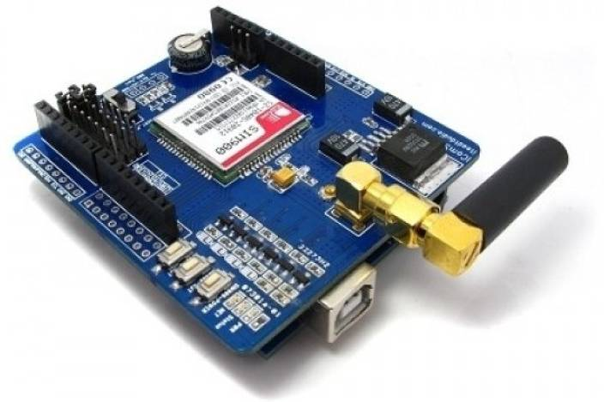
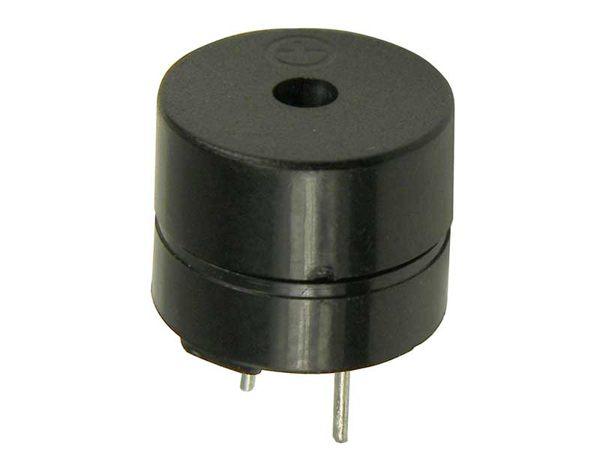
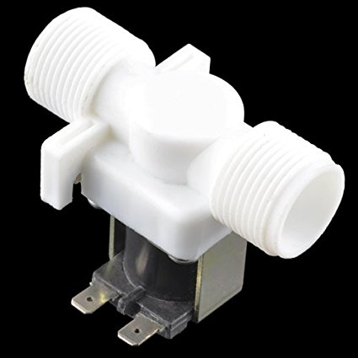
GAS LEAKAGE ACTION
TURN ON THE ALARM
SYSTEM
TURN OFF THE MAIN GAS LINE WITH 12 V DC VALVE
Cut-Off the Main Electricity Line,
Use Backup Line using Solid State Relay Switch
EXHAUST THE GAS WITH EXHAUST FAN
INFORM THE AUTHORITIES WITH SIM900 GSM MODULE

Slide 6

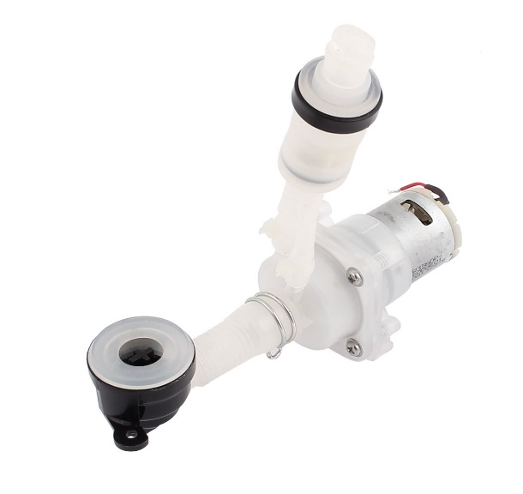
FIRE OUTBREAK ACTION
TURN ON THE ALARM SYSTEM WITH BUZZER AND LED
TURN OFF THE MAIN GAS LINE WITH 12 V DC VALVE
INFORM THE AUTHORITIES WITH SIM900 GSM MODULE
Spray Water using Water Pump DC-12V

Slide 7

TOXIC AIR RELEASE ACTION
TURN ON THE ALARM SYSTEM WITH BUZZER AND LED
DISPLAY APPROPRIATE MESSAGE IN LCD DISPLAY
EXHAUST THE GAS WITH EXHAUST FAN
INFORM THE AUTHORITIES WITH SIM900 GSM MODULE

Slide 8
Conclusion
With this system –
It might be possible to automate industrial safety
Minimize damage
Save lives

Slide 9


Slide 10


